Slide 1
Java Web
JSTL – JSP Standard Tag Library

Slide 2
Disclaimer
Document Name:
Data Classification: INTERNAL
Disclaimer
The contents of this document are property of Softtek, and are classified as Confidential. Any reproduction in whole or in part is strictly prohibited without the written permission of Softtek.
This document is subject to change. Comments, corrections or questions should be directed to the author.
Audience/Viewership | Purpose
Java Beginners | Training
Revision Chart
The following chart list the revisions made to this document. Use this to describe the changes and additions each time this document is re-published. The description should be detailed as possible and include the names of the reviewers who request the changes.
Version No. | Version Date | Types of Changes | Owner/Author | Date of Review/Expiration
1 | 2015/08/07 | Creation | Luis Robles | NA

Slide 3
Lesson 4: JSP Standard Tag Library

Slide 4
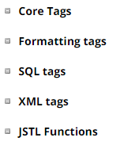
Concepts
The JavaServer Pages Standard Tag Library (JSTL) is a collection of useful JSP tags which encapsulates core functionality common to many JSP applications.
JSTL has support for common, structural tasks such as iteration and conditionals, tags for manipulating XML documents, internationalization tags, and SQL tags. It also provides a framework for integrating existing custom tags with JSTL tags.
The JSTL tags can be classified, according to their functions, into following JSTL tag library groups that can be used when creating a JSP page:

Slide 5
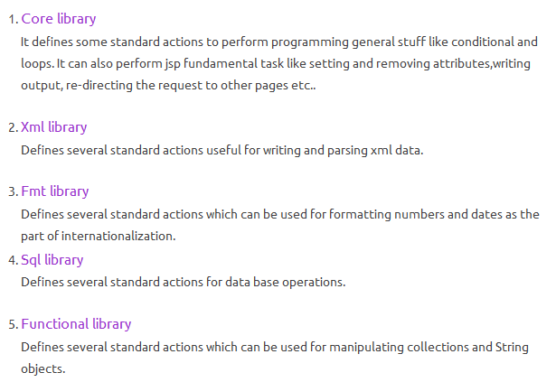
Sub-Libraries

Slide 6
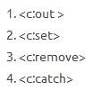

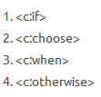
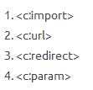
Core tags
General purpose tags
Conditional tags
Iteration tags
URL related tags

Slide 7
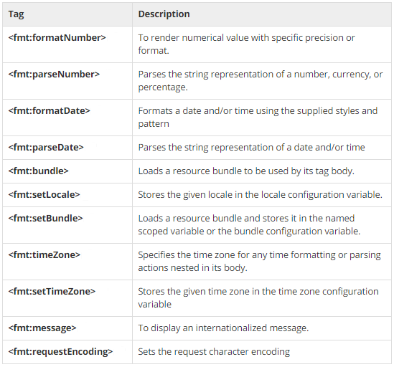
Formatting tags
The JSTL formatting tags are used to format and display text, the date, the time, and numbers for internationalized Web sites

Slide 8
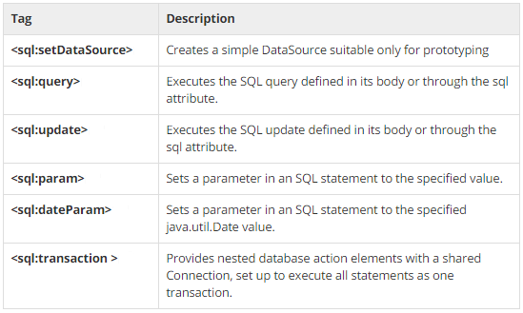
SQL tags
The JSTL SQL tag library provides tags for interacting with relational databases (RDBMSs) such as Oracle, mySQL, or Microsoft SQL Server

Slide 9
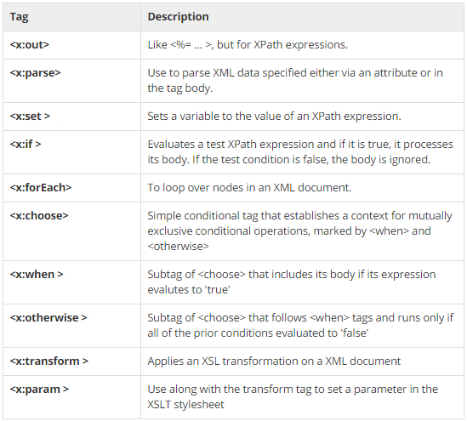
XML tags
The JSTL XML tags provide a JSP-centric way of creating and manipulating XML documents. Following is the syntax to include JSTL XML library in your JSP.
The JSTL XML tag library has custom tags for interacting with XML data. This includes parsing XML, transforming XML data, and flow control based on XPath expressions.

Slide 10
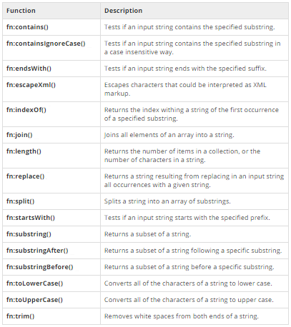
JSTL functions
JSTL includes a number of standard functions, most of which are common string manipulation functions

Slide 11
Links and References
http://docs.oracle.com/javaee/5/tutorial/doc/bnakc.html
https://docs.oracle.com/javaee/6/tutorial/doc/
http://json-taglib.sourceforge.net/tutorial.html

Slide 13
Luis Robles
luisf.robles@softtek.com
Related to training material
(Java Web module)
Erio Cesar García Lujan
erio.garcia@softtek.com
Instructor

